Slide 1

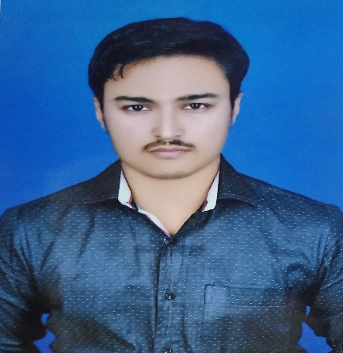





SAURABH KUMAR
Education and certificates Bachelor of Technology
Computer Science Engineering :
2018 - 2022
Skills
Analyst/A4
Base Location: Mumbai
Email ID:
saurabh.ah.kumar@capgemini.com
Java 8 /J2EE | Java Basics, OOPS, Generics, Collections, Arrays, Loops, Lambda Exp, Stream API Junit, Mockito, Servlets
Spring core | IOC & Dependency Injection, Autowire
Spring REST | REST controllers, Implementation of GET, POST, PUT & DELETE, Bean Validation & Exception Handling, Testing Services, Controller & Repository layer
Spring Data JPA | Implement DAO layer using spring Data repositories, Transaction Management
Spring Boot Microservi ces | Spring Boot Starters, annotations, Messaging Service, Sync/Async comms, Swagger API documents
Spring Cloud | Eureka, Netflix Ribbon, Feign Client, Netflix Hystrix, Netflix Zuul & Config Server
React | Components, Hooks, Event handling, Redux, Reducers, Testing
Database | MongoDB No Sql Basics My SQL RDS Basics
UI Tech | HTML 5 & CSS 3,JavaScript, Optimized UI Designed
Tools | Git, Postman, Maven, IDE
Add On skills | Communications, Team management. Peer learning
Mobile No: Grade: A4
+91 9122720653
Strengths
Full Stack Developer
Achievement
Hands on experience in creating microservices with Springboot, Spring Security with JWT, Role Based Authorization, Swagger, Eureka server, Spring Cloud API Gateway, Payment Gateway.
Employee Management System(Monolithic Project)
Completed end to end case study of Employee Management System along with Spring Boot and responsive UI with HTML5, CSS3, Bootstrap, ReactStrap and React js.
Proficient in creating Single Page Web Application in React, React routing, HTML5, CSS3, Bootstrap5, ReactStrap, Validators, React UI Kit.
Railway Reservation System
Completed end to end case study of Railway Reservation System Application along with JWT authentication, Swagger and payment testing using Paytm, responsive UI with CSS, HTML5, Bootstrap, Reactstrap and React js used for user interface.
Hands on experience in implementing Mongo dB Atlas & PostgreSQL.
Development experience in transferring messages using a message-queueing software RabbitMQ.
Completed a three months Training for A4 Analyst of
Capgemini India.
LinkedIn : https://www.linkedin.com/in/saurabhkumar001
Check out my work on GitHub & Video Profile
Presentation Title | Author | Date © Capgemini 2017. All rights reserved | 1

